Slide 1
DIGITAL PORTFOLIO
STUDENT NAME : SAINDHAVI.S
REGISTER NO AND NMID: asbru4w422k2144
DEPARTMENT: BSC.COMPUTER SCIENCE
COLLEGE: BHARADHIYAR UNIVERSITY
CONTENT CREATOR : 2025-2026

Slide 2

PROJECT TITLE
SAINDHAVI’S
DIGITAL PORTFOLIO

Slide 3

Problem statement
Project overview
Tools and technologies
Portfolio design and layout
Features and functionality
Results and screenshots
Conclusion
GitHub link

Slide 4
PROBLEM STATEMENT
Many students lack practical experience in developing real-world applications, despite learning programming concepts in class. This project focuses on designing a basic mobile app to solve a common student problem, thereby improving programming, UI design, and problem-solving skills.
Students often struggle to understand how theoretical business models apply to real-life enterprises. This project investigates the marketing strategies of a local business to evaluate their effectiveness and propose improvements based on classroom theories.
In many educational settings, students face challenges in effectively understanding and applying theoretical knowledge to real-world situations. This gap between academic concepts and practical implementation often results in reduced engagement, limited critical thinking, and poor problem-solving skills.

Slide 5
PROJECT OVERVIEW
Here’s a Project Overview that specifically focuses on students creating a Digital Portfolio. This format is ideal for middle school, high school, or even college students working on a cumulative or reflective assignment.
Purpose of the Project :
The digital portfolio project allows you to showcase your learning, growth, and achievements throughout the term or year. It’s a creative and organized way to reflect on your academic journey and present your best work in a digital format.
Tips for Success :
Start early and manage time wiselyUse credible sourcesPractice your presentationAsk for feedback before the deadlineBe respectful and cooperative in group work

Slide 6
TOOLS AND TECHNOLOGIES
🔧 Essential Tools for Writing HTML
1. Text Editors:
- VS Code (Visual Studio Code)
- Sublime Text
- Notepad++
- Atom
- Brackets
2. Web Browsers (for testing):
- Google Chrome
- Mozilla Firefox
- Microsoft Edge
- Safari
3. Developer Tools:
- Chrome DevTools ( inspect element , console, etc.)
- Firefox Developer Tools
4. Version Control:
- Git
- GitHub(for hosting and sharing code)

Slide 7
PORTFOLIO DESIGN AND LAYUOT
Here’s a clear and practical guide to Portfolio Design and Layout — ideal for students creating a digital portfolio or even a physical one. This includes tips on structure, visual appeal, and user experience.
Portfolio Layout : The layout of your portfolio is how your content is visually organized and structured. A good layout helps others navigate your work easily and makes your content more impressive and engaging.
Final Checklist:
Is your portfolio easy to navigate?
Is the design consistent across pages?
Did you include meaningful reflections, not just images?
Is everything spell-checked and formatted correctly?
Would someone get a good sense of your skills by viewing it?

Slide 8
FEATURES AND FUNCTIONALITY
Digital portfolio:
Is an online collection of your work that showcases your skills, accomplishments, and experiences. It’s commonly used by professionals in creative fields (like design, writing, photography), students, and job seekers. Below is a breakdown of features and functionalities typically included in a digital portfolio:
The portfolio is designed to be responsive, ensuring it looks good on desktops, tablets, and smartphones. It often includes navigation menus for smooth browsing between sections. Some portfolios have interactive elements like dark mode toggles, animations, or real-time updates (e.g., displaying current time). Contact forms enable visitors to send messages directly. Additionally, integration with social media and platforms like GitHubor LinkedIn allows users to connect and verify work.
Overall, the functionality ensures the portfolio is easy to update, visually appealing, and accessible to potential employers, educators, or collaborators.

Slide 9
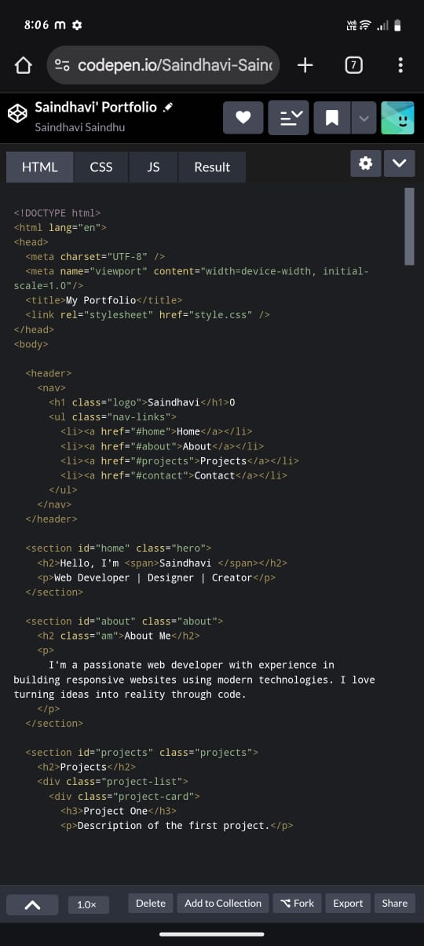
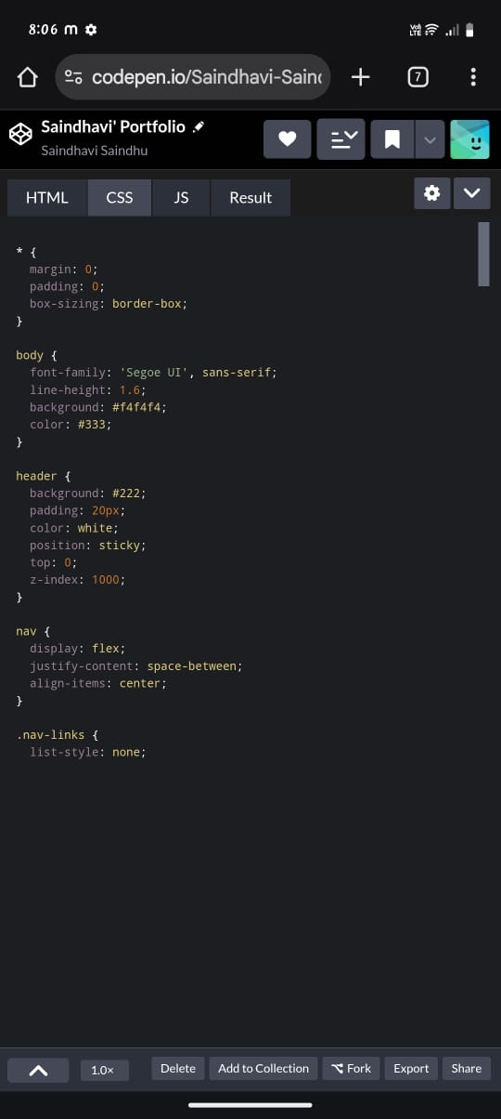
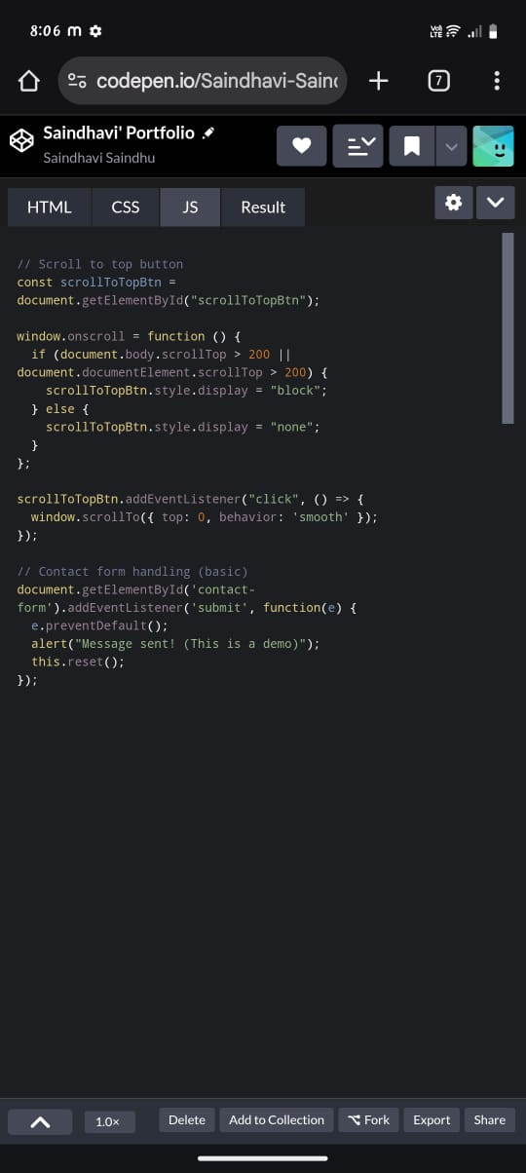
RESULTS AND SCREENSHOT
HTML
CSS
JAVA SCRIPT

Slide 10
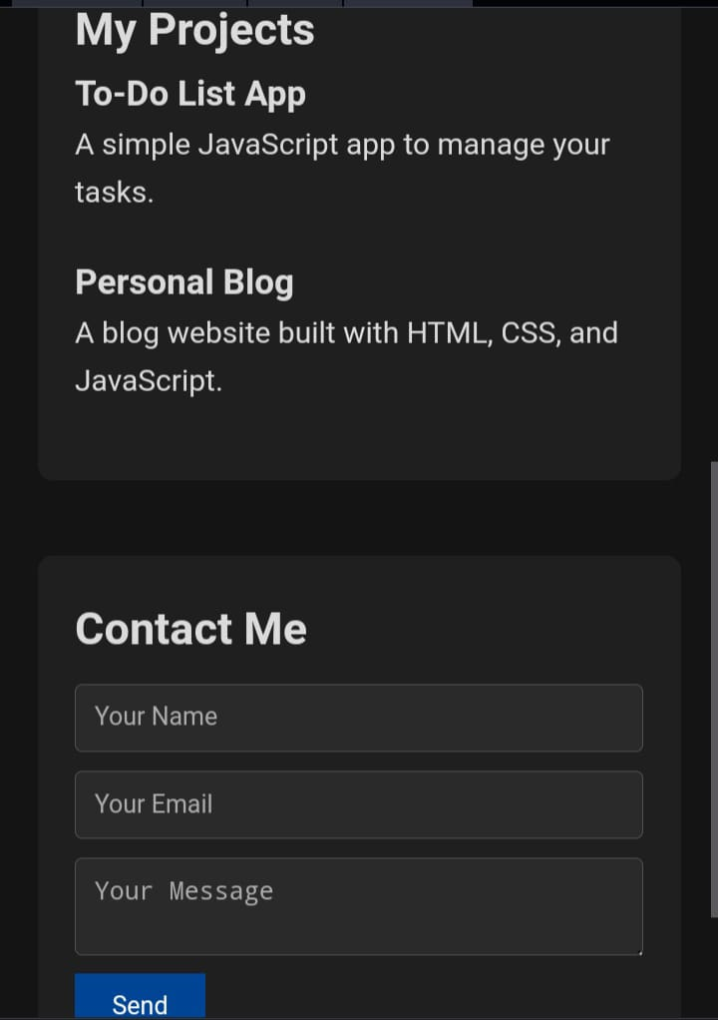
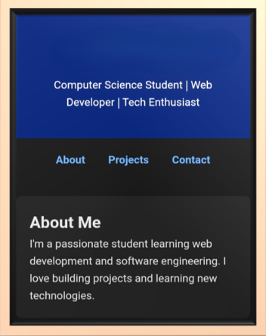
RESULTS AND SCREENSHOT
Hi I’m Saindhavi

Slide 11
CONCLUTION
The digital portfolio is a powerful tool for showcasing personal, academic, or professional achievements in an interactive and visually engaging way. Unlike a traditional resume, it provides a dynamic platform where individuals can present their skills, projects, experiences, and creativity in real time.
Through a well-structured digital portfolio, users can:
a)Highlight their strengths and demonstrate real-world applications of their abilities,
b)Stand out in competitive academic or job markets,
c)Build a personal brand and online presence,
d)Connect with employers, collaborators, or clients more effectively.

Slide 12

PRESENTED BY:
S.SAINDHAVI
Thank you

